Slide 1

A couple of announcements (unrelated to class)
"Last Lecture“
A unique perspective a professor would like to tell students, as if it were the final lecture of his or her career.

Slide 2
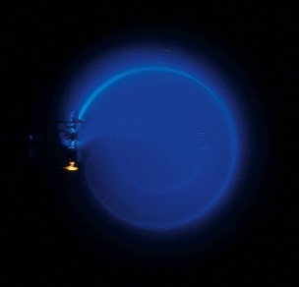
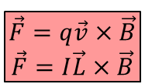




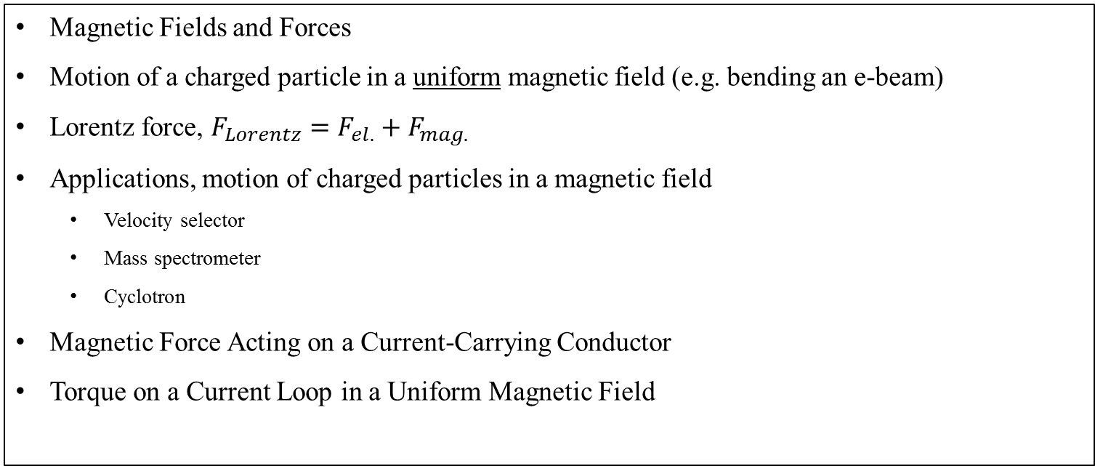

Chapter 29: Magnetic fields
Reading assignment: Chapter 29
Homework 29.1 (due Friday, April 5): OQ1, OQ2, OQ4, OQ5, OQ8, OQ9, OQ10, QQ1, 1, 2, 3, 5, 8, 9
Homework 29.2 (due Monday, April 8): OQ6, QQ3, 22, 24, 25, 26, 33, 34, 39
Homework 29.3 (due Friday, April 12): QQ4, 46, 48, 53
Magnetic Fields and Forces
Motion of a charged particle in a uniform magnetic field (e.g. bending an e-beam)
Lorentz force, $F_{Lorentz}=F_{el.}+F_{mag.}$
Applications, motion of charged particles in a magnetic field
  Velocity selector
  Mass spectrometer
  Cyclotron
Magnetic Force Acting on a Current-Carrying Conductor
Torque on a Current Loop in a Uniform Magnetic Field
$$\vec{F}=q\vec{v}×\vec{B}$$
$$\vec{F}=q\vec{E}+q\vec{v}×\vec{B}$$
$$\vec{F}=q\vec{v}×\vec{B}$$
$$\vec{F}=I\vec{L}×\vec{B}$$
$$\vec{F}=I\vec{L}×\vec{B}$$
$$\vec{τ}=I\vec{A}×\vec{B}$$
$$\vec{τ}=\vec{μ}×\vec{B}$$

Slide 3
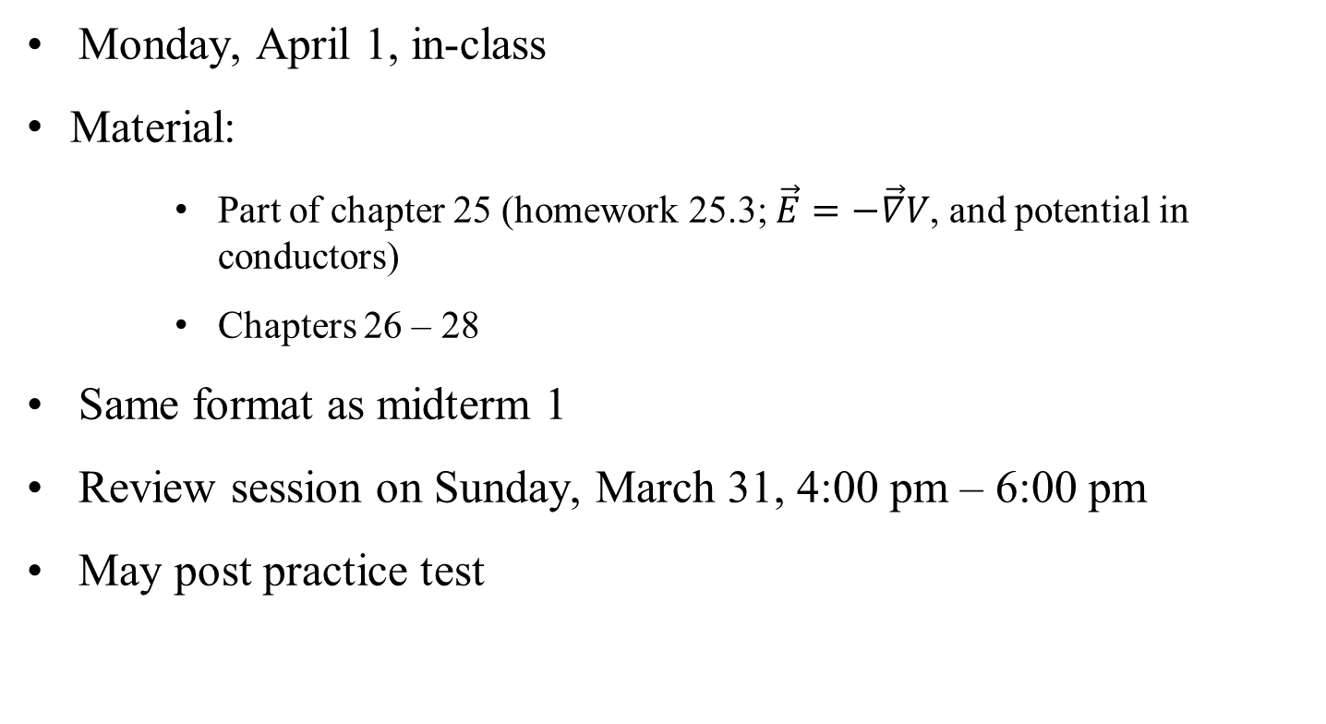
Midterm 2
Monday, April 1, in-class
  Material:
  Part of chapter 25 (homework 25.3; $\vec{E}=−\vec{∇}V$, and potential in conductors)
  Chapters 26 – 28
Same format as midterm 1
Review session on Sunday, March 31, 4:00 pm – 6:00 pm
May post practice test

Slide 4
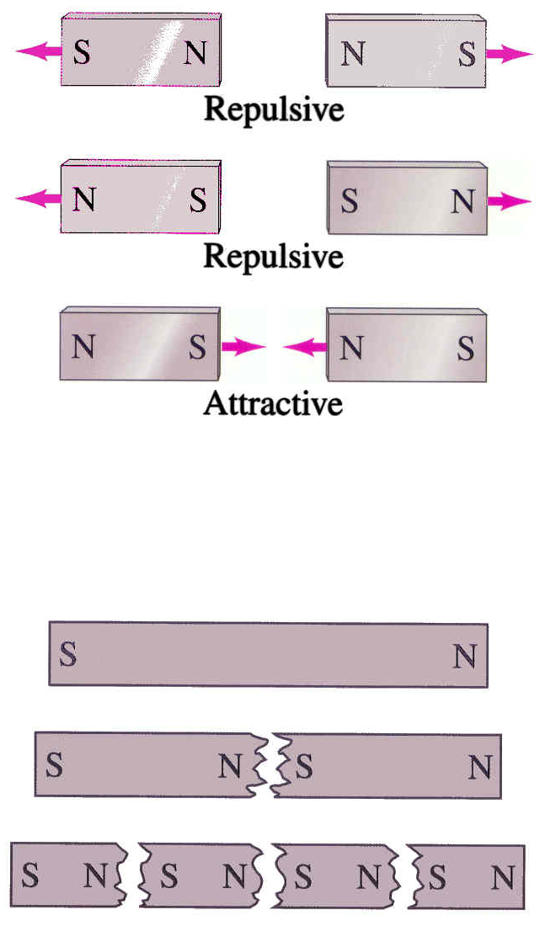
Magnets and Magnetic fields
Some general properties
Magnets have a north and a south pole
Like poles repel, opposite poles attract
Only a few elements (iron, cobalt, nickel, gadolinium, neodymium (strong!)) show strong magnetic effects (ferromagnetic materials)
There are no magnetic monopoles, i.e., when cutting a magnet, the magnet is not separated into south and north, but two new magnets are obtained. (Electric charges are different, since a single electric charge does exist.)
Magnets are surrounded by a magnetic field; charges are surrounded by an electric field.

Slide 5
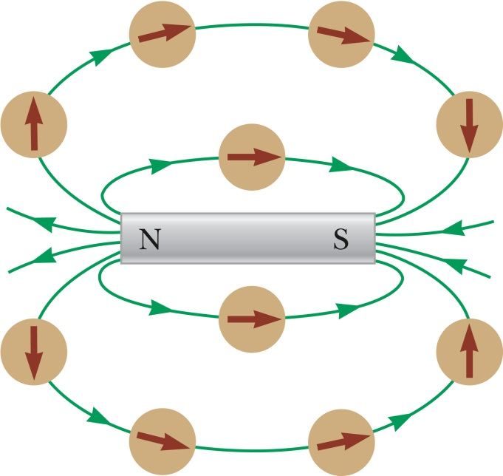
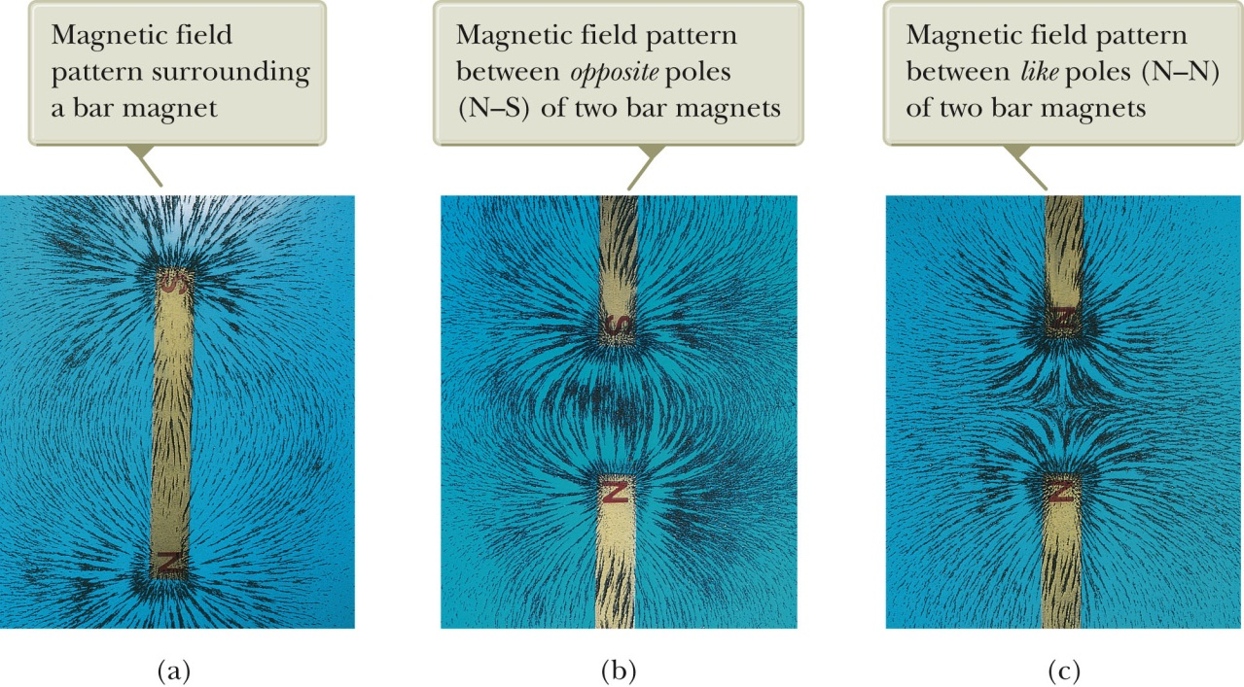
Magnetic field lines
The force one magnet exerts on an other can be described as the interaction between one magnet and the magnetic field of the other.
Can draw magnetic field lines (see below).
The direction of the magnetic field is tangent to a line at any point.
The number of lines per unit area is proportional to the magnitude of the field.
Outside a magnet: the lines point from the North to the South pole. (The direction in which the North pole of a compass needle would point.

Slide 6
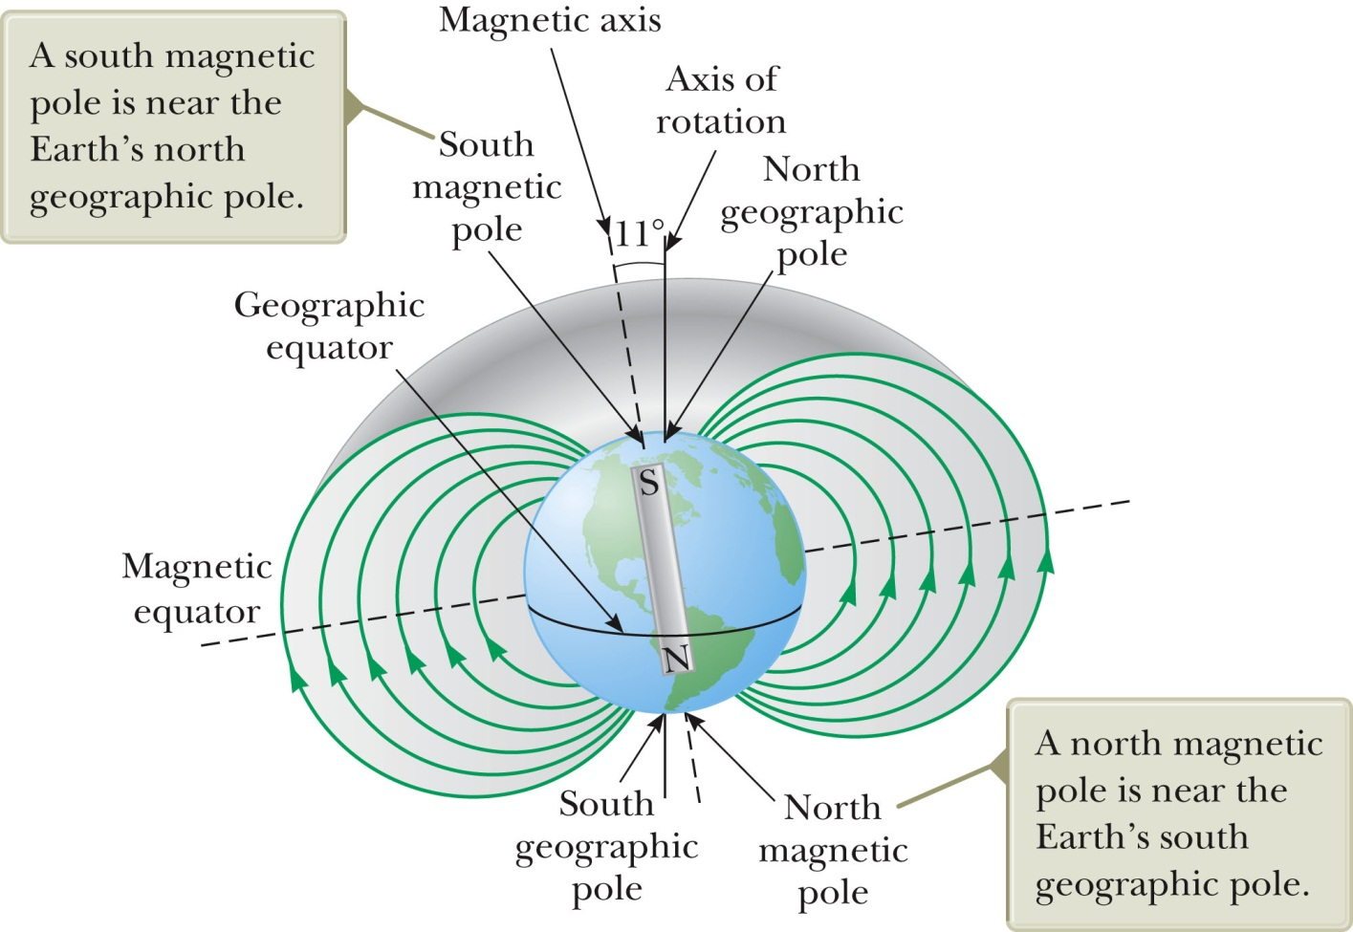
A few facts about Earth’s magnetic field
The earth has a magnetic field. Earth acts like a huge magnet in which the south pole of the earth’s magnet is north. (North pole of a compass needle points towards it.)
Magnetic poles are not at geographic poles, pole is in Northern Canada. Deviation between true north (rotation axis) and magnetic north is called magnetic declination.
The angle that the earth’s magnetic field makes with the horizontal at any point is referred to as the angle of dip.

Slide 7
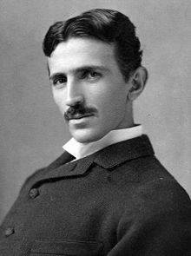
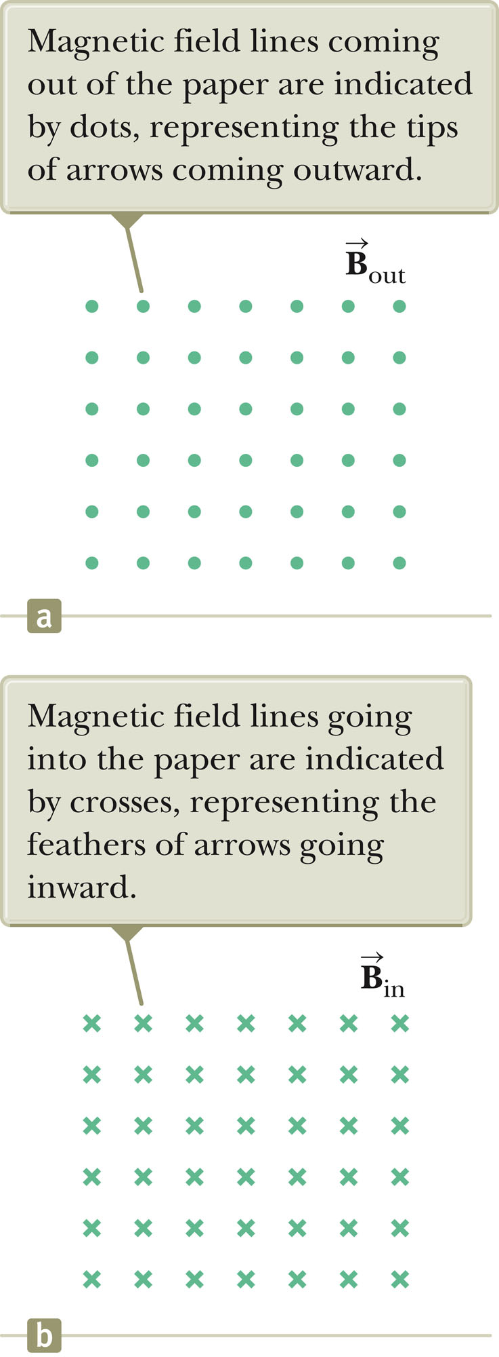
Symbol for magnetic field lines going in and coming out of page
Magnetic field usually is denoted B-field
Unit of magnetic field are Tesla
Nikola Tesla

Slide 8
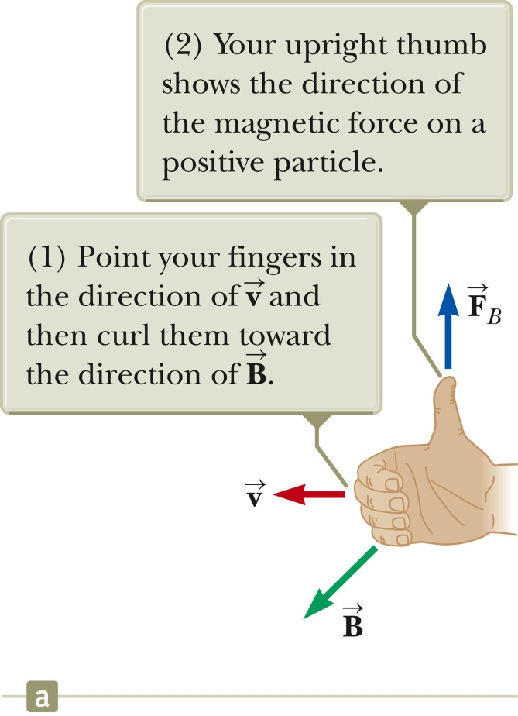
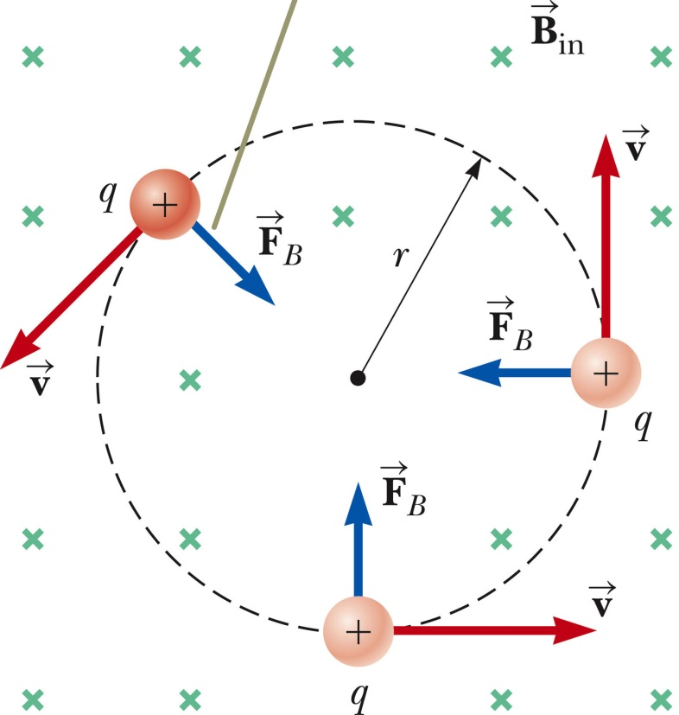
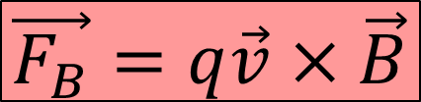
Force, F_{B}, of an electric charge moving in a magnetic field (magnetic force)
A positive charge, q, moving in a magnetic field, B, with velocity, v, experiences a force F:
$$\vec{F_{B}}=q\vec{v}×\vec{B}$$
Cross product!!
Force is perpendicular to B and v.
Right hand rule:
F – thumb;
v – index finger;
B – middle finger

Slide 9
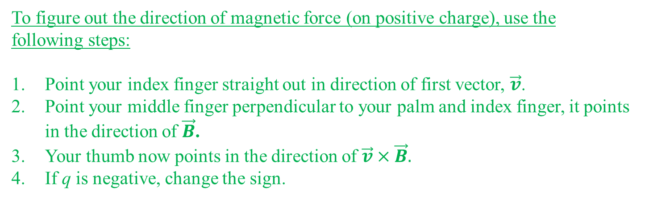
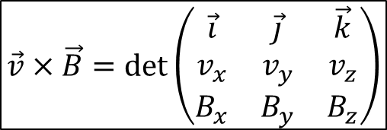

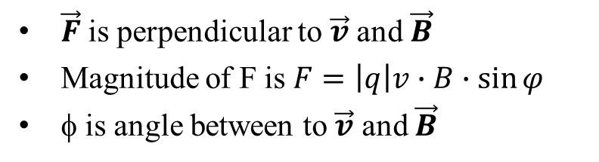
Brief review of cross product and the Right Hand Rule
$$\vec{F}=q\vec{v}×\vec{B}$$
To figure out the direction of magnetic force (on positive charge), use the following steps:
Point your index finger straight out in direction of first vector, $\vec{v}$.
Point your middle finger perpendicular to your palm and index finger, it points in the direction of $\vec{B}$.
Your thumb now points in the direction of $\vec{v}×\vec{B}.$
If q is negative, change the sign.
v × B
$\vec{F}$is perpendicular to $\vec{v}$ and $\vec{B}$
Magnitude of F is $F=\left|q\right|v∙B∙\sin{φ}$
φ is angle between to $\vec{v}$ and $\vec{B}$
v
B
$$\vec{v}×\vec{B}=\det\left(\begin{matrix}\vec{i} & \vec{j} & \vec{k} \\ v_{x} & v_{y} & v_{z} \\ B_{x} & B_{y} & B_{z}\end{matrix}\right)$$
$$\vec{v}×\vec{B}={(v}_{y}B_{z}−v_{z}B_{y})\vec{i}+{(v}_{z}B_{x}−v_{x}B_{z})\vec{j}+{(v}_{x}B_{y}−v_{y}B_{x})\vec{k}$$

Slide 10
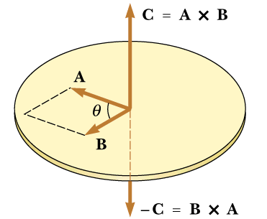
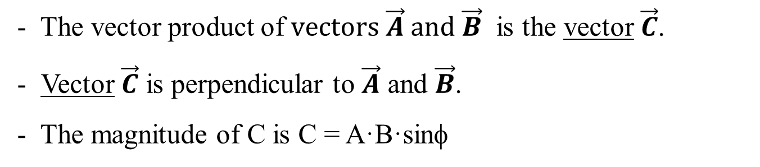
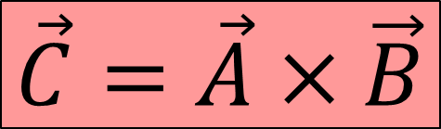
Definition of vector product:
$$\vec{C}=\vec{A}×\vec{B}$$
φ
- The vector product of vectors $\vec{A}$ and $\vec{B}$ is the vector $\vec{C}$.
Vector $\vec{C}$ is perpendicular to $\vec{A}$ and $\vec{B}$.
The magnitude of C is C = A·B·sinφ

Slide 11
$$\vec{C}=\vec{A}×\vec{B}$$
φ
φ
φ
φ
Use the right hand rule to figure out the direction of C.
Thumb is C (or force F)
Index finger is A (or velocity v)
Middle finger is B (or magnetic field B)

Slide 12
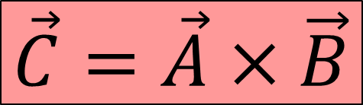
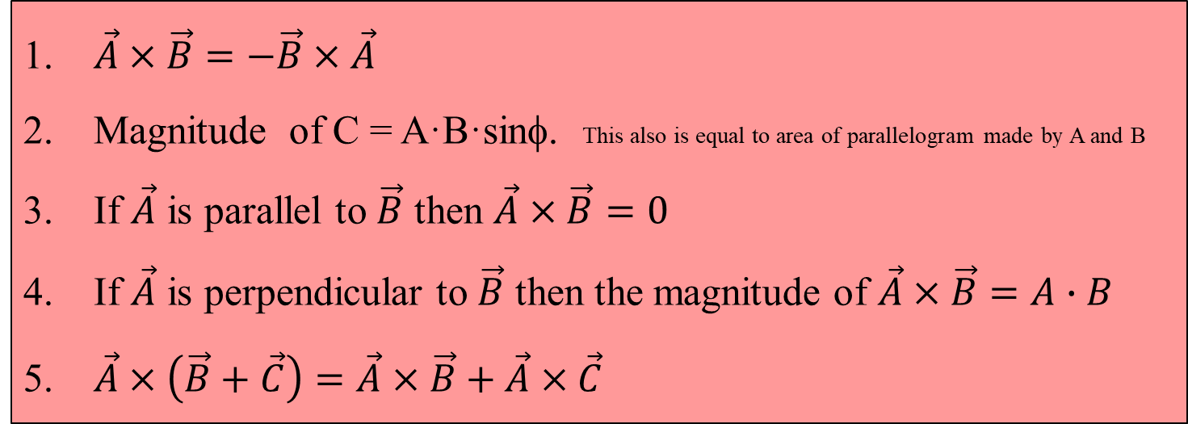
Rules for the vector product.
φ
φ
φ
φ
$$\vec{C}=\vec{A}×\vec{B}$$
$\vec{A}×\vec{B}=−\vec{B}×\vec{A}$
Magnitude of C = A·B·sinφ. This also is equal to area of parallelogram made by A and B
If $\vec{A}$ is parallel to $\vec{B}$ then $\vec{A}×\vec{B}=0$
If $\vec{A}$ is perpendicular to $\vec{B}$ then the magnitude of $\vec{A}×\vec{B}=A∙B$
$\vec{A}×\left(\vec{B}+\vec{C}\right)=\vec{A}×\vec{B}+\vec{A}×\vec{C}$

Slide 13

Rules for the vector product (cont).
φ
φ
φ
$$\vec{C}=\vec{A}×\vec{B}$$
φ
6. $\vec{A}×\vec{B}={(A}_{y}B_{z}−A_{z}B_{y})\vec{i}+{(A}_{z}B_{x}−A_{x}B_{z})\vec{j}+{(A}_{x}B_{y}−A_{y}B_{x})\vec{k}$

Slide 14


Finding the direction, three i-clickers
proton
What is the direction of the force for each of the situations sketched?
A) B) C) D)
E) None of the above
B
p
v
$$\vec{F}=q\vec{v}×\vec{B}$$
$$F=\left|q\right|v∙B∙\sin{φ}$$
3. If q is negative, change the sign
Ca⁺² ion
electron
B
e
v
Ca
B
v

Slide 15
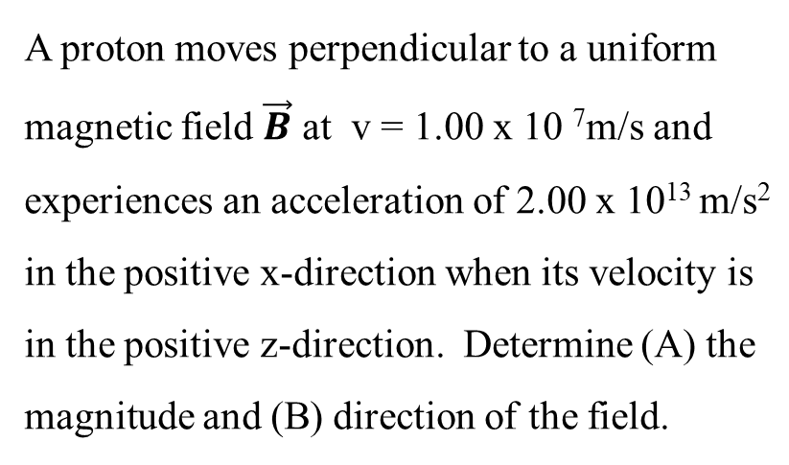
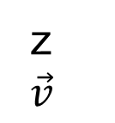

White board examples
A proton moves with a velocity v = (2i − 4j + k) m/s in a region in which the magnetic field is B = (i + 2j − k) T. What is the magnitude of the magnetic force this particle experiences?
A proton moves perpendicular to a uniform magnetic field $\vec{B}$ at v = 1.00 x 10 ⁷m/s and experiences an acceleration of 2.00 x 10¹³ m/s² in the positive x-direction when its velocity is in the positive z-direction. Determine (A) the magnitude and (B) direction of the field.
z
$$\vec{v}$$
+
x
$$\vec{F}$$
y axis goes into the page
B comes out of the page

Slide 16
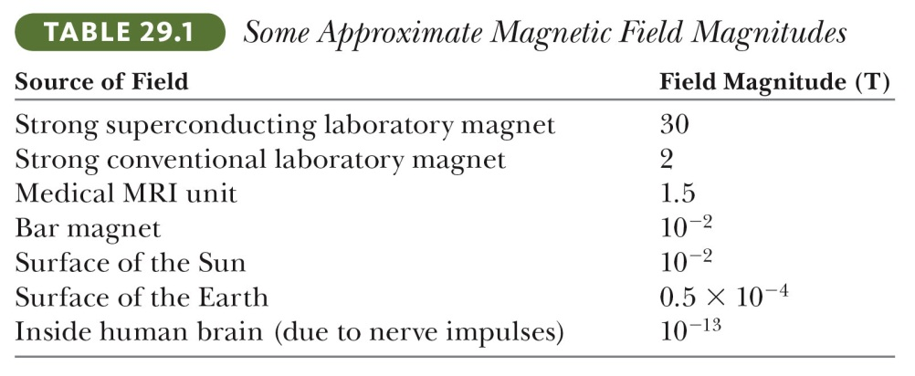



Differences between Electric and Magnetic Forces & Fields
$$\vec{F}=q\vec{E}$$
$$\vec{F}=q\vec{v}×\vec{B}$$
Electric force is a vector along electric field, magnetic force is a vector perpendicular to magnetic field
Electric force acts on charged particles, regardless of whether they are moving; magnetic force only acts on moving charged particles
The electric field does work in displacing a charged particle, whereas magnetic force (associated with steady magnetic field) does no work, when displacing particle (force is perpendicular to displacement).
Magnetic field strength is measured in a unit called Tesla, abbreviated T
  A Tesla is a large amount of magnetic field. Another unit is gauss (10⁴ G = 1T)
$$Units of Tesla:B=\frac{F}{qv} \sim \frac{N}{C∙m/s}=\frac{N}{A∙m}=T$$

Slide 17


Application: Cyclotron Motion
Consider a particle of mass m and charge q moving in a uniform magnetic field of strength B:
$$\vec{F}=q\vec{v}×\vec{B}$$
Motion is uniform circular motion
Centripetal force formula
Centripetal force is equal to magnetic force
B
v
v
F
F
F
q
F
v
v
Let’s find how long it takes to go around:

Slide 18
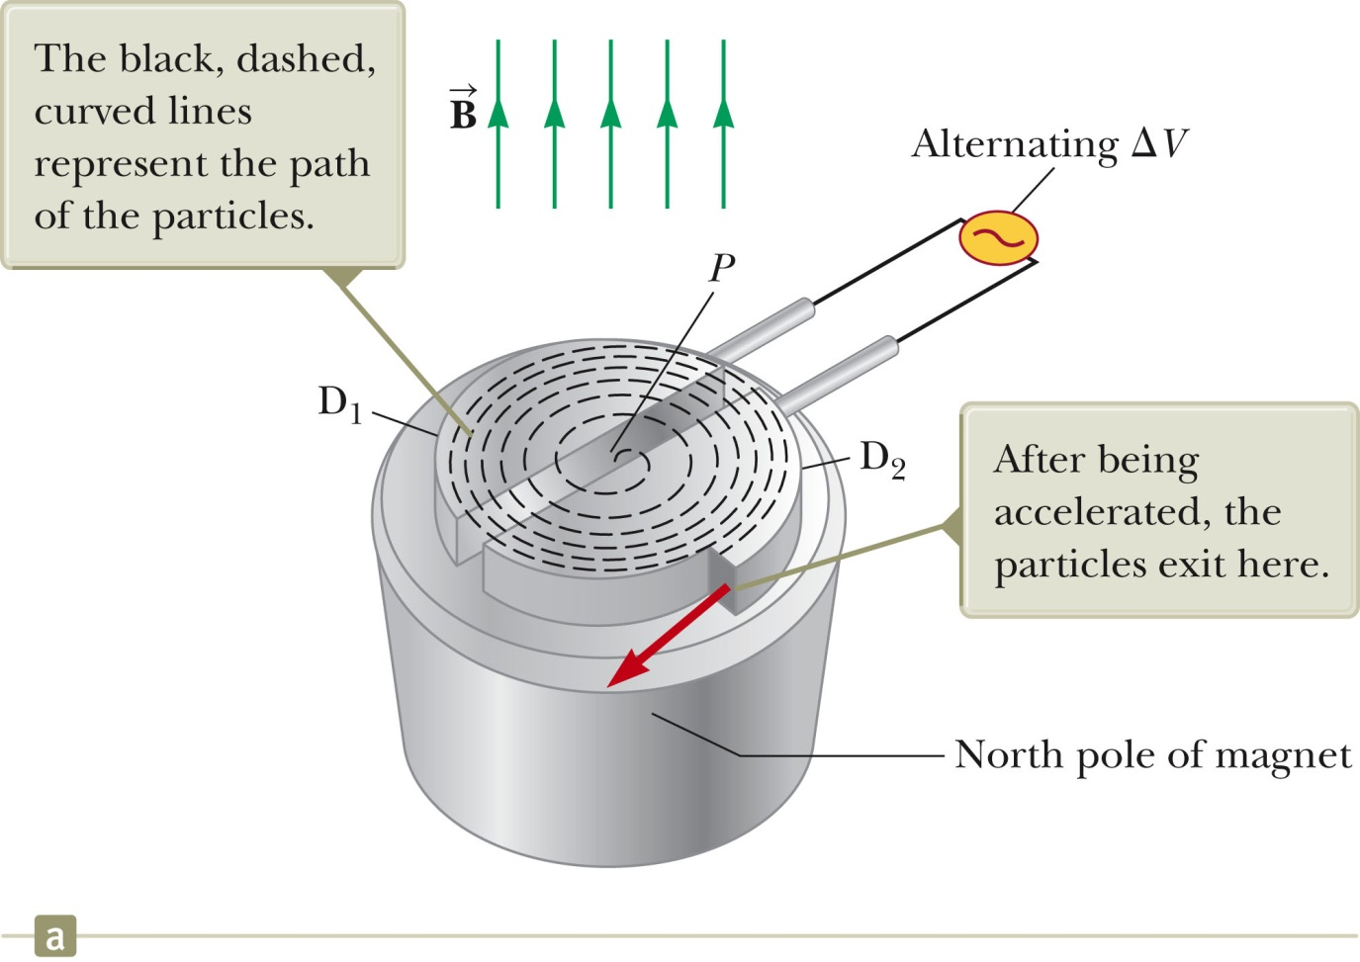
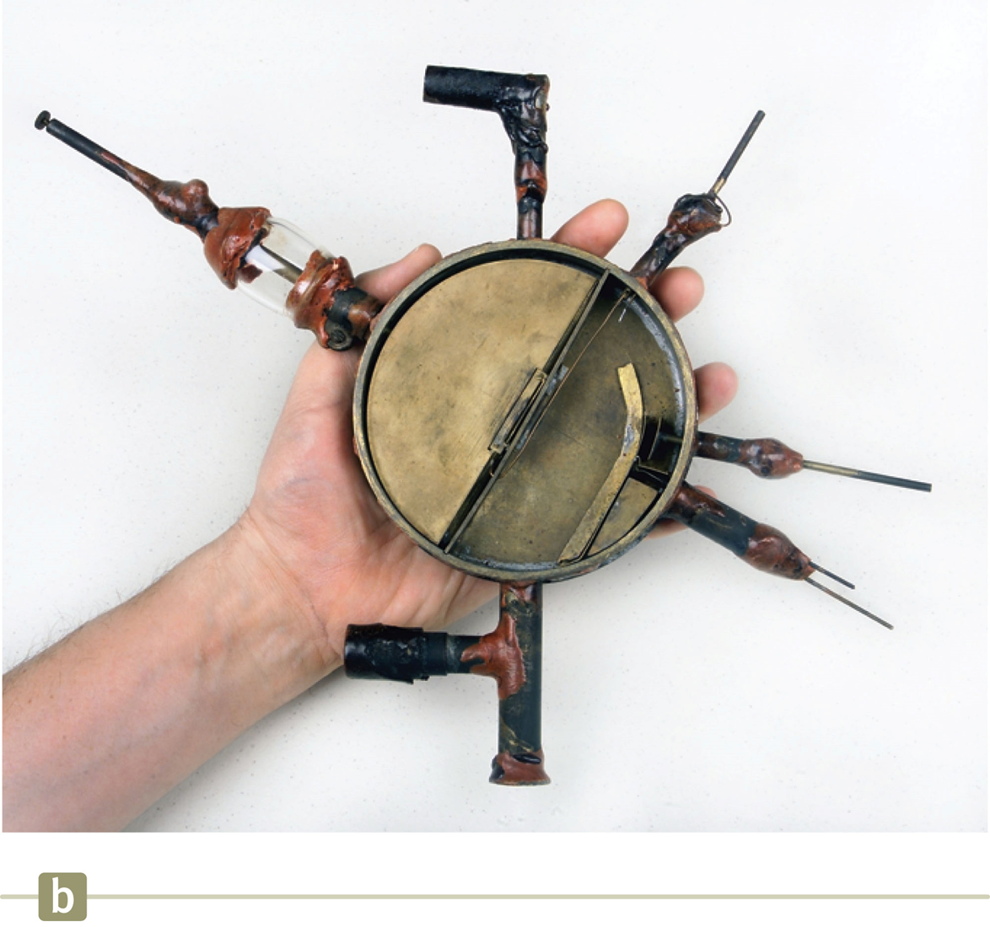
Application: Cyclotron as a particle accelerator
(combined electric and magnetic forces)
First cyclotron, invented by Lawrence & Livingston, 1934
Electric field accelerates particles, magnetic field moves them in a circle
Particle gets accelerated multiple times → extremely high speeds
Used to bombard atomic nuclei and produce nuclear reaction → can create radioactive materials for diagnosis and treatment

Slide 19
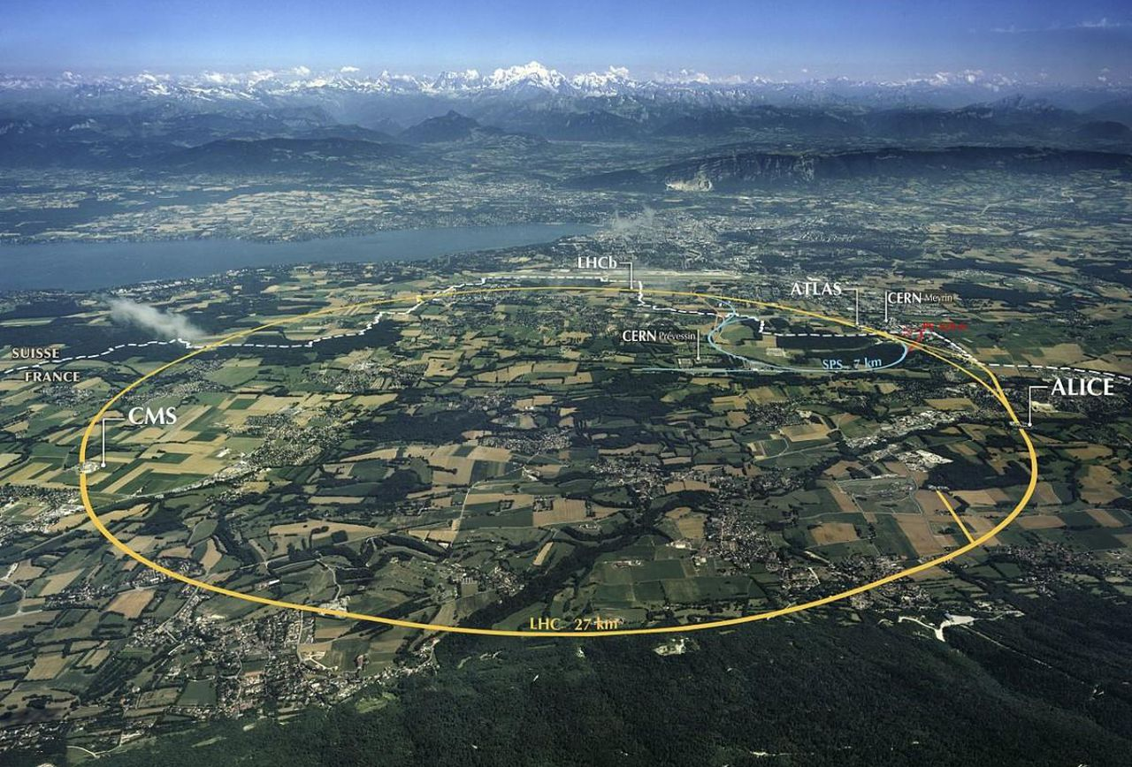
The largest particle accelerator: CERN
(CERN = Conseil Européen pour la Recherche Nucléaire = European Organization for Nuclear Research)
Geneva
Echenevex
Aerial view of CERN. Image credit: Maximilien Brice (CERN).

Slide 20
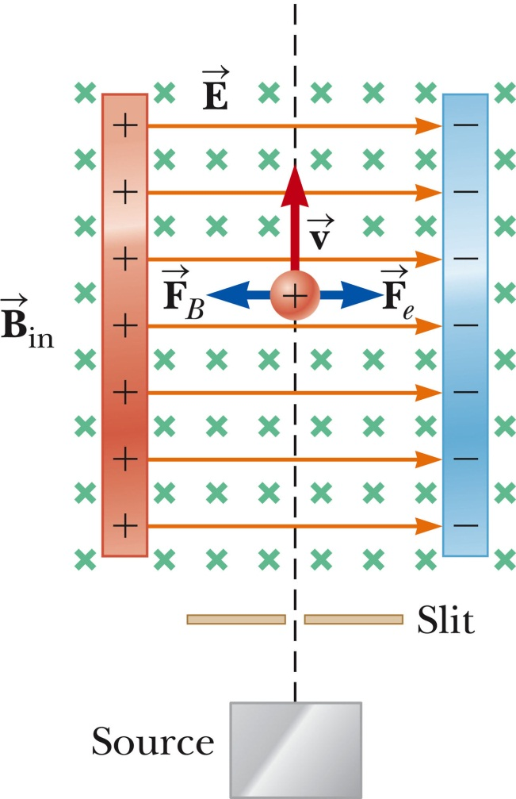

Application: Velocity Selector
Allows you to select particles with a particular velocity.
              Particles are accelerated and enter a region with an electric and magnetic field.
              They experience electric and magnetic force (Lorentz force)
              → Only particles with a particular velocity make it through
$$\vec{F}=q\vec{E}+q\vec{v}×\vec{B}$$

Slide 21
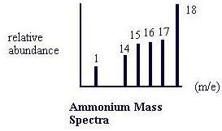
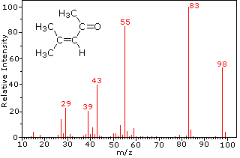
Application: Mass Spectrometer
(Important instrument in analytical chemistry, with many different applications)
Separates ions (or ionized molecules) according to their mass-to-charge ratio
Allows identification of molecules in a mixture by their mass-to-charge ratio
B₀
First, ionize/atomize samples (e.g. bombard with electrons), then let ions pass through velocity selector (electric field E and magnetic field B).
Next, move into region with magnetic field, B₀ only.
Particle path bends due to cyclotron motion
Measure final position on detector (radius R)
Allows you to determine m/q of particle
+
–
F_{B}
detector
R
v
F_{E}
Derive on board
Can you assign the peaks in the ammonium spectrum?
http://www2.chemistry.msu.edu/faculty/reusch/VirtTxtJml/Spectrpy/MassSpec/masspec1.htm
4-methyl-3-pentene-2-one
http://encyclopedia.che.engin.umich.edu/Pages/ProcessParameters/Spectrometers/Spectrometers.html

Slide 22
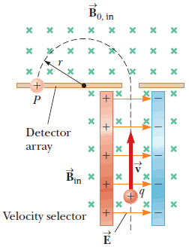
White board example
Mass spectrometer
Consider the mass spectrometer shown schematically in the figure below. The magnitude of the electric field between the plates of the velocity selector is 2.50·10³ V/m, and the magnetic field in both the velocity selector and the deflection chamber has a magnitude of 0.0400 T.
Calculate the radius of the path for a singly charged ion having a mass, m = 2.18·10⁻²⁶ kg.

Slide 23
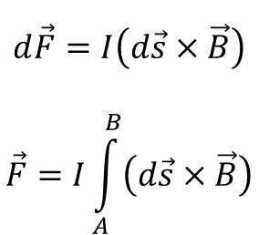
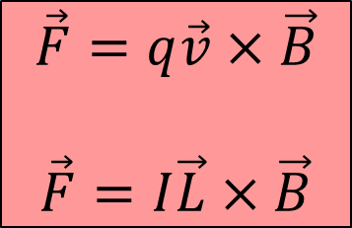
Force on a Current-Carrying Wire
Moving charges experience a force, F = qv^{x}B; → current in wire experiences force!
Suppose current I is flowing through a wire of cross sectional area A and length L
    Think of length as a vector L in the direction of current
    Think of current as charge carriers with charge q and drift velocity v_{d}
B
I
$$\vec{F}=q\vec{v}×\vec{B}$$
$$\vec{F}=I\vec{L}×\vec{B}$$
L
F
What if magnetic field is non-uniform, or wire isn’t straight?
Divide it into little segments
Add them up
$$d\vec{F}=I\left(d\vec{s}×\vec{B}\right)$$
$$\vec{F}=I\int_{A}^{B}{\left(d\vec{s}×\vec{B}\right)}$$
I
B
A

Slide 24

White board example
Measuring a magnetic field.
A rectangular loop of wire hangs vertically. The B-field is uniform, directed horizontally, and perpendicular to the wire and points out of the page. The top portion of the wire is free of the field. The downward magnetic force is F_{B} = 3.48x10⁻² N when the wire carries a current of I = 0.245 A. What is the magnitude of the B-field.
I
I
10.0 cm
$$\vec{F}$$
B field towards viewer

Slide 25




White Board example
A wire having a mass per unit length of 0.500 g/cm carries a 2.00 A current horizontally to the south. What are the direction and magnitude of the minimum magnetic field needed to lift this wire vertically upward?
$$\vec{F_{B}}$$
N
$$\vec{B}$$
W
E
$$I\vec{L}$$
S
$$m\vec{g}$$

Slide 26



Force/Torque on a current Loop in a uniform magnetic field
Consider a square loop (sides L) perpendicular to a uniform magnetic field, B
Force on a current-carrying wire in an external magnetic field:
3D view:
F
$$\vec{F}=I\vec{L}×\vec{B}$$
r
$$\vec{B}$$
These forces create a torque:
F
$$\vec{τ}=I\vec{A}×\vec{B}$$
derive on board

Slide 27

Force/Torque on a current Loop in a uniform magnetic field
Consider a rectangular loop perpendicular to a uniform magnetic field
Force on a current-carrying wire in an external magnetic field:
Side view:
F
$$\vec{F}=I\vec{L}×\vec{B}$$
I
$$\vec{B}$$
These forces create a torque:
F
$$\vec{τ}=I\vec{A}×\vec{B}$$
derive on board

Slide 28
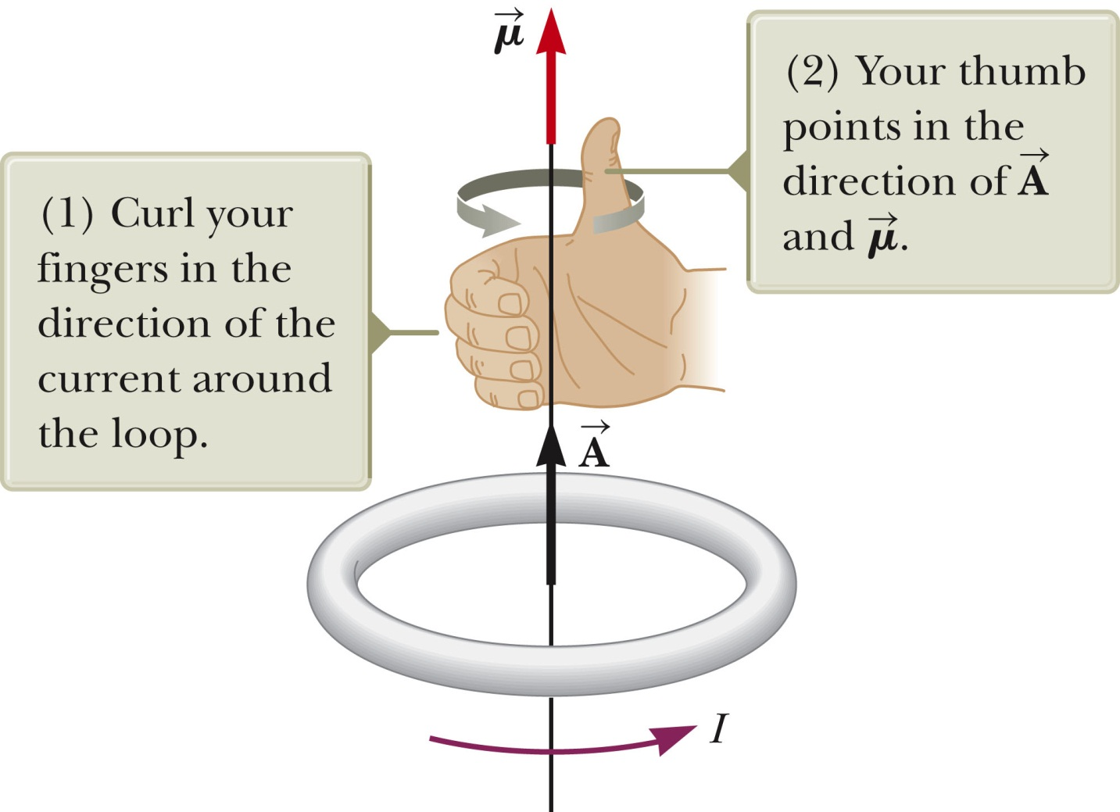

Definition of the magnetic moment of a current-carrying loop
N
$$\vec{μ}=I\vec{A}$$
S

Slide 29

Torque (i.e., twisting force) on a current carrying loop.
We can also think of this torque in relation to a magnetic dipole moment μ, where μ=IA
Then
$$\vec{τ}=\vec{μ}×\vec{B}$$
F
I
μ
N
N
S
s
I
F
The current loop turns clockwise

Slide 30
Torque (i.e., twisting force) on a current carrying loop.
I
N
s
N
S
I

Slide 31
Electric Motor:
s
N
N
S

Slide 32
Electric Motor:
Switch current direction
N
s
N
S

Slide 33
Electric Motor:
N
s
N
S

Slide 34
Electric Motor:
N
s
N
S

Slide 35
Electric Motor:
s
N
N
S

Slide 36
Electric Motor:
Switch current direction
N
s
N
S

Slide 37
Electric Motor:
N
s
N
S

Slide 38
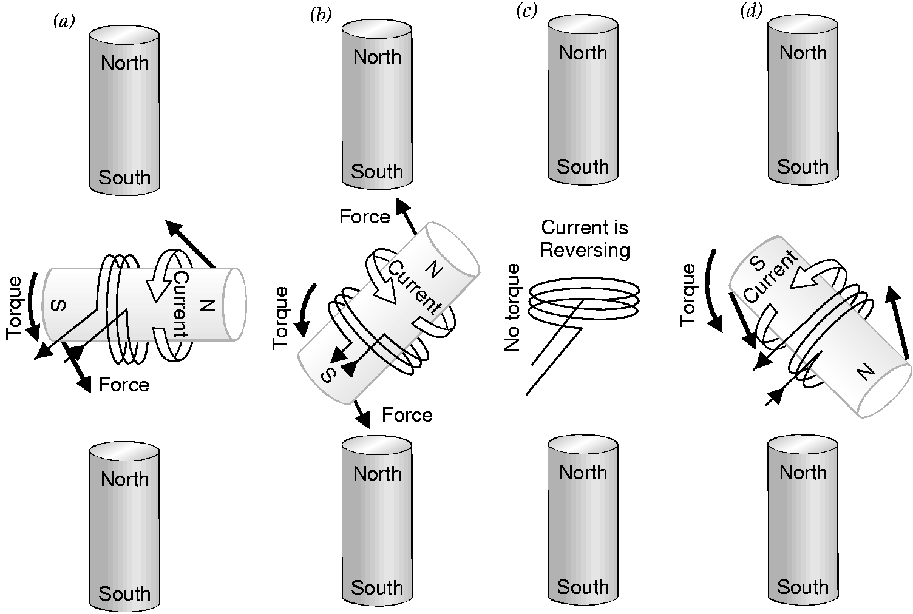
How does an electric motor work?
stator
rotor
stator

Slide 39
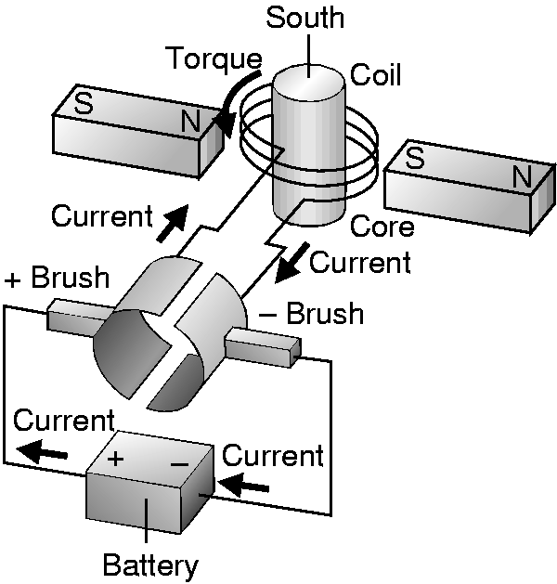
DC motor
How is the direction of the current switched??
Commutator

Slide 40
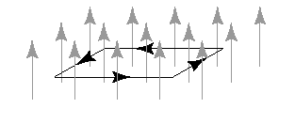


i-clicker
A rectangular loop is placed in a uniform magnetic field with the plane of the loop perpendicular to the direction of the field. If a current flows through the loop as shown by the arrows, the field exerts on the loop:
a net force
a net torque.
a net force and a net torque.
neither a net force nor a net torque.
$$\vec{F}=I\vec{L}×\vec{B}$$
$$\vec{τ}=\vec{μ}×\vec{B}$$

Slide 41
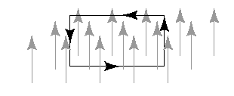
i-clicker
A rectangular loop is placed in a uniform magnetic field with the plane of the loop parallel to the direction of the field. If a current flows through the loop as shown by the arrows, the field exerts on the loop:
a net force
a net torque.
a net force and a net torque.
neither a net force nor a net torque.
$$\vec{F}=I\vec{L}×\vec{B}$$
$$\vec{τ}=\vec{μ}×\vec{B}$$

Slide 42
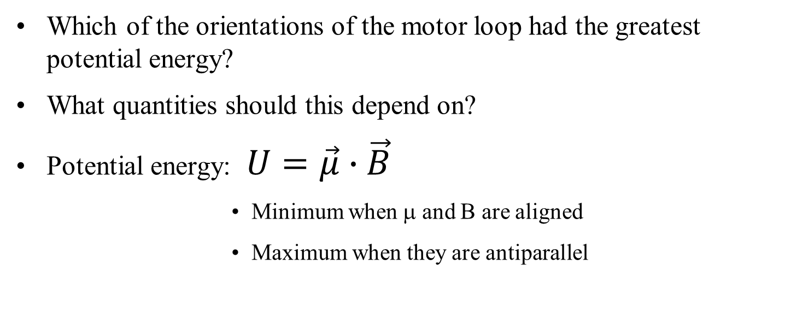
Potential energy of a magnetic moment in a B field
Which of the orientations of the motor loop had the greatest potential energy?
What quantities should this depend on?
Potential energy: $U=\vec{μ}∙\vec{B}$
  Minimum when μ and B are aligned
  Maximum when they are antiparallel
I
N
s
N
S
I

Slide 43

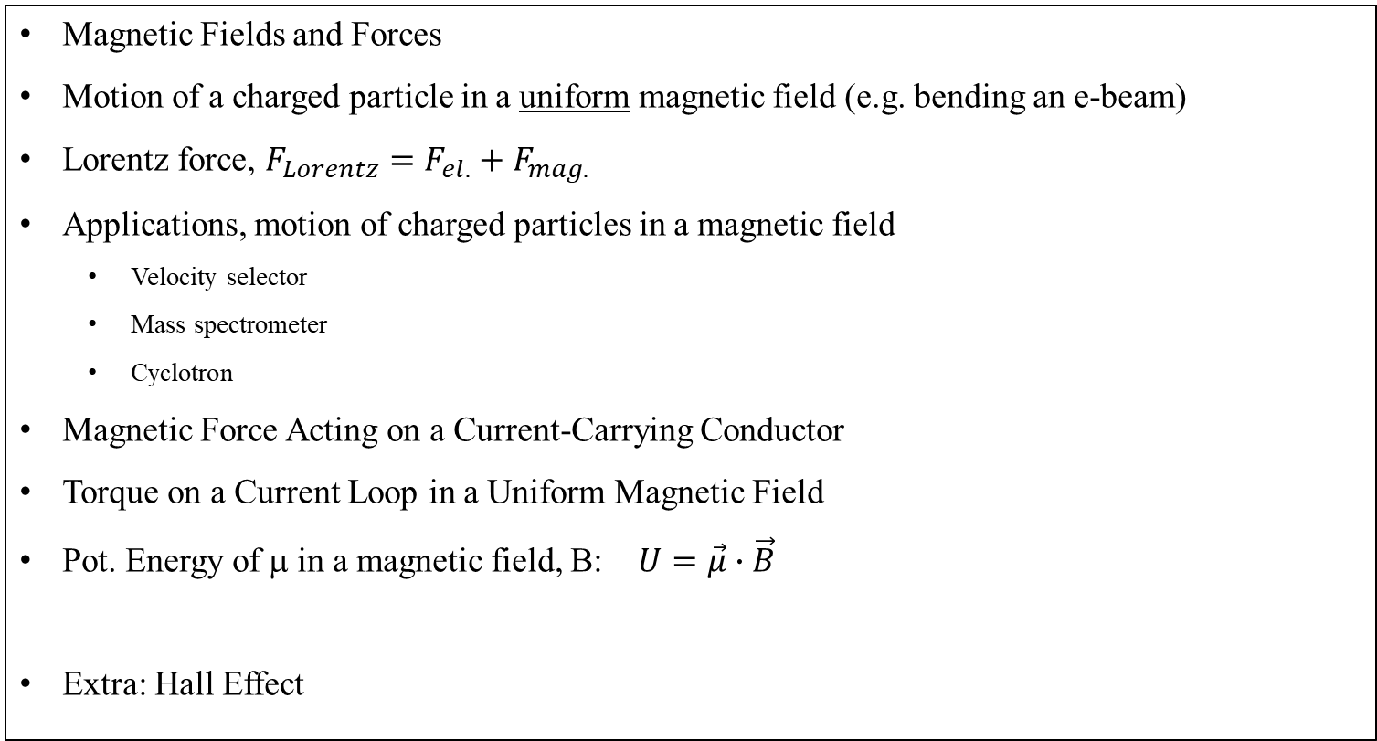



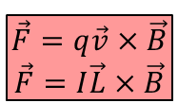
Review
Magnetic Fields and Forces
Motion of a charged particle in a uniform magnetic field (e.g. bending an e-beam)
Lorentz force, $F_{Lorentz}=F_{el.}+F_{mag.}$
Applications, motion of charged particles in a magnetic field
  Velocity selector
  Mass spectrometer
  Cyclotron
Magnetic Force Acting on a Current-Carrying Conductor
Torque on a Current Loop in a Uniform Magnetic Field
Pot. Energy of μ in a magnetic field, B: $U=\vec{μ}∙\vec{B}$
Extra: Hall Effect
$$\vec{F}=q\vec{v}×\vec{B}$$
$$\vec{F}=q\vec{E}+q\vec{v}×\vec{B}$$
$$\vec{F}=q\vec{v}×\vec{B}$$
$$\vec{F}=I\vec{L}×\vec{B}$$
$$\vec{τ}=I\vec{A}×\vec{B}$$
$$\vec{τ}=\vec{μ}×\vec{B}$$

Slide 44
Extra Slides

Slide 45
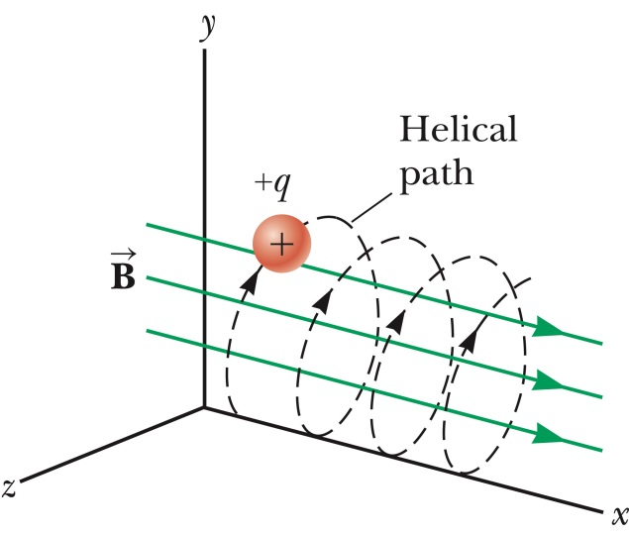
Application: Helical Motion in a Magnetic Field
Charged particle may start with a velocity component parallel to the magnetic fields.
    Magnetic force
→ Combined motion is a helix
  Net motion is helical path along magnetic field lines → charged particles follow magnetic field lines in a helical path.
B
q

Slide 46
White board example
Uranium-235 vs. Uranium238 detection
Uranium-235 and Uranium-238 are two naturally occurring isotopes of Uranium. The fraction of Uranium-235 in natural deposits is only about 0.72%, and the rest is Uranium-238
Uranium-235 is naturally fissile, and, if at high enough concentrations, it can be used in nuclear reactions and nuclear bombs. 3-4% Uranium-235 are needed in a reactor and >90% are needed for a nuclear bomb.
Singly charged uranium-238 ions are accelerated through a potential difference of 2.00 kV and enter a uniform magnetic field of magnitude 1.2 T directed perpendicular to their velocities.
Determine the radius of their circular path.
Repeat this calculation for uranium-235 ions.
(c) How does the ratio of these path radii depend on the accelerating voltage?
(d) How does the ratio of these path radii depend on the magnitude of the magnetic field?

Slide 47
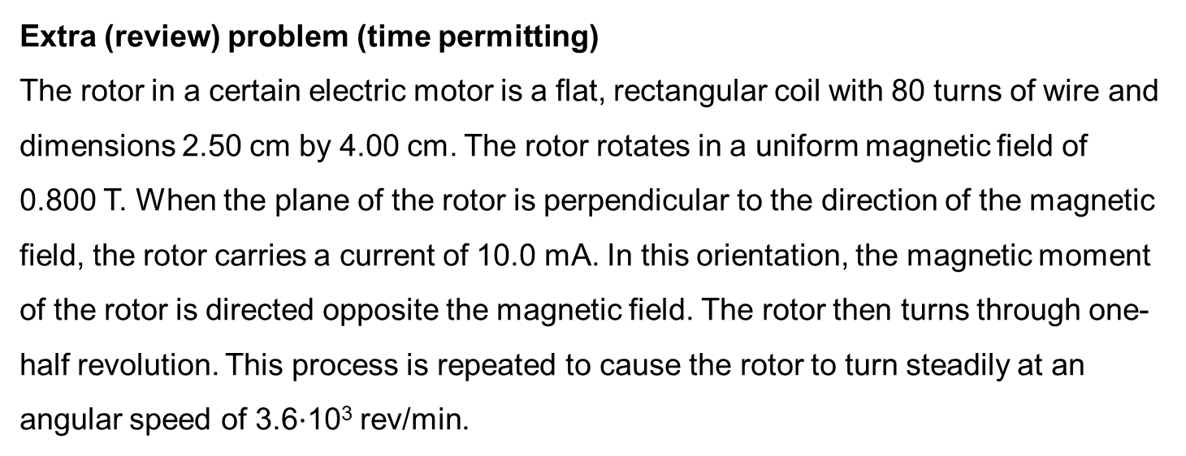
Extra (review) problem (time permitting)
The rotor in a certain electric motor is a flat, rectangular coil with 80 turns of wire and dimensions 2.50 cm by 4.00 cm. The rotor rotates in a uniform magnetic field of 0.800 T. When the plane of the rotor is perpendicular to the direction of the magnetic field, the rotor carries a current of 10.0 mA. In this orientation, the magnetic moment of the rotor is directed opposite the magnetic field. The rotor then turns through one-half revolution. This process is repeated to cause the rotor to turn steadily at an angular speed of 3.6$·$10³ rev/min.
Find the maximum torque acting on the rotor.
Find the peak power output of the motor (review problem).
Determine the amount of work performed by the magnetic field on the rotor in every full revolution (review problem).
Find the average power of the motor (review problem).

Slide 48
Hall Effect
Discovered by Edwin Hall as a graduate student in 1879
Charges moving along a flat conductor will feel a magnetic force if a magnetic field is applied perpendicular to the conductor.
Magnetic force on those charges is in the same direction whether they are (+) or (-)
BUT sign of voltage across the conductor differs between these two cases!
→ Can be used to determine if charge carriers are positive or negative; and to determine drift velocity

Slide 49
The Hall effect, Hall voltage, V_{H}
Consider a current carrying wire in a magnetic field
  Let’s assume it’s actually electrons this time, because it usually is
I
F_{B}
v_{d}
V_{H}
d
t
Electrons are moving at an average velocity of v_{d}
  To the left for electrons
Because of magnetic field, electrons feel a force upwards
Electrons accumulate on top surface, positive charge on bottom
Eventually, electric field develops that counters magnetic force
This can be experimentally measured as a voltage
Derive on board

